Slide 1





DIVYA DARSHINI R
(311521104013)
Final Project
GENERATIVE AI
3/21/2024Annual Review
1

Slide 2

PROJECT TITLE
IDENTIFICATION OF LANGUAGE USING GENERATIVE AI
3/21/2024Annual Review
2

Slide 3



AGENDA
PROBLEM STATEMENT
PROJECT REVIEW
WHO ARE THE END USERS?
YOUR SOLUTION AND ITS VALUE PRE-POSITION
THE WOW IN YOUR SOLUTION
MODELING
RESULT
3/21/2024Annual Review
3

Slide 4

PROBLEM STATEMENT
Develop an LSTM-based Language Identification System that, when given
a text input, can accurately identify the language of the text. The goal is to create
a system that can classify input text into various languages by learning the
linguistic patterns and features from a dataset of multilingual texts.
Users should be able to input text of varying lengths and styles, and the system
should accurately predict the language of the input text.
The system success will be evaluated based on its ability to correctly
identify the language of the input text, considering factors such as
accuracy, precision, and recall.
3/21/2024Annual Review
4

Slide 5

PROJECT OVERVIEW
The Language Identification System project aims to develop an innovative
system capable of automatically identifying the language of input text based on
user-provided samples.
Leveraging advanced machine learning techniques, particularly deep learning
algorithmssuch as Long Short-Term Memory (LSTM)
networks, this project addresses the need for a versatile tool that assists linguists,
researchers, and language enthusiasts in analyzing and categorizing
textual datainmultiple languages.
3/21/2024Annual Review
5

Slide 6
WHO ARE THE END USERS?
The end users of language identification systems can vary depending on the
Specific application and context. Here are some potential end users:
Software Developer
Content Moderators
Language Service Providers
Researchers
Global Enterprises
Government Agencies
Educational Institutions
3/21/2024Annual Review
6

Slide 7

YOUR SOLUTION AND ITS VALUE PROPOSITION
Accuracy and Reliability: Our solution utilizes state-of-the-art machine learning techniques, including deep learning models such as transformers, to achieve high accuracy and reliability in language identification.
Scalability and Adaptability: Our solution is designed to scale and adapt to diverse linguistic contexts and evolving language landscapes.
Efficiency and Speed: Our solution offers fast and efficient language identification capabilities, enabling real-time or batch processing of large volumes of text data.
Customization and Integration: Our solution can be customized and integrated into existing workflows, applications, and platforms to meet specific business requirements.
Privacy and Compliance: We prioritize data privacy and compliance with regulatory requirements such as GDPR.
3/21/2024Annual Review
7

Slide 8

THE WOW IN YOUR SOLUTION
Unmatched Accuracy: Our solution achieves near-human-level accuracy in identifying languages from diverse text sources, ensuring precise results even in complex scenarios.
Continuous Learning: Our solution continuously learns and adapts to new languages, dialects, and linguistic variations, staying ahead of emerging trends and evolving linguistic landscapes.
User-Friendly Integration: Intuitive APIs, SDKs, and documentation make integration effortless, catering to developers of all skill levels and seamlessly fitting into existing workflows.
Scalability: Whether analyzing small text snippets or processing massive datasets, our solution scales effortlessly to meet the demands of any use case, ensuring consistent performance and reliability.
3/21/2024Annual Review
8

Slide 9
MODELLING
Language identification involves building models that can automatically classify
text data into different language categories. Here's a high-level overview of
the modeling process for language identification:
Data Collection and Preprocessing
Feature Extraction
Model Selection
Training
Evaluation
Testing and Deployment
Monitoring and Maintenance
Advanced Techniques
3/21/2024Annual Review
9

Slide 10
RESULTS
Language identification serves as a cornerstone for deciphering textual content across linguistic boundaries.
Through meticulous modeling and rigorous evaluation, it proficiently discerns the language of text inputs, fostering seamless communication and comprehension amidst diverse linguistic landscapes. This pivotal process enhances efficiency and precision in handling multilingual data, empowering applications across a myriad of domains.
10

Slide 11
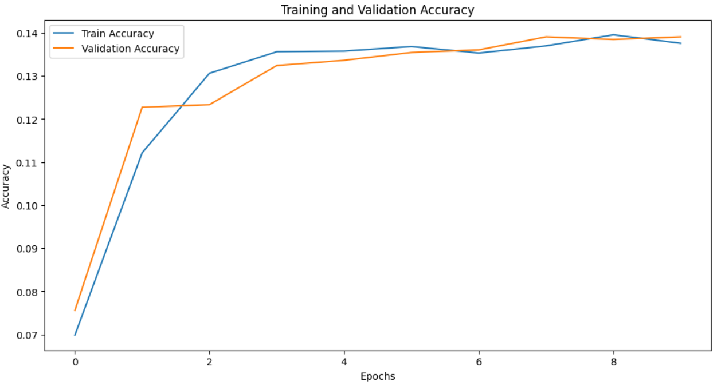
OUTPUT:
10

Slide 12

Demo Link
https://github.com/divyadarshini003/TNSDC-Generative-AI.git

